Slide 1
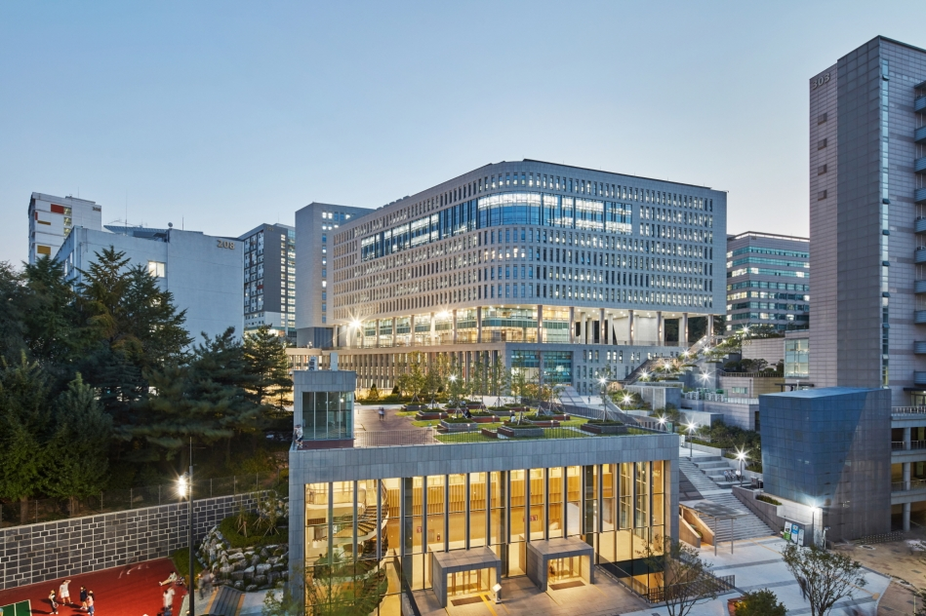
DMAIS Lab Seminar Orientation
2024-07-09
Data Mining And Intelligence Systems (DMAIS) Lab
School of Computer Science and Engineering
Chung-Ang University

Slide 2
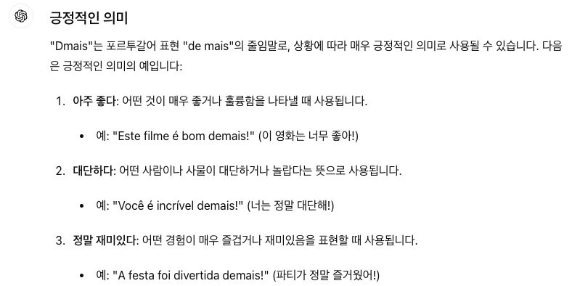
Who Are We?
Lab: Data Mining And Intelligence Systems (DMAIS) Lab
Research Interests
Data mining, Deep learning, Recommender systems, Graph neural networks, Time-series anomaly detection, Knowledge graphs, Social network analysis, …

Slide 3
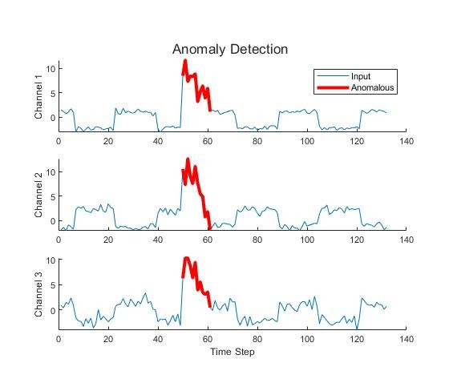
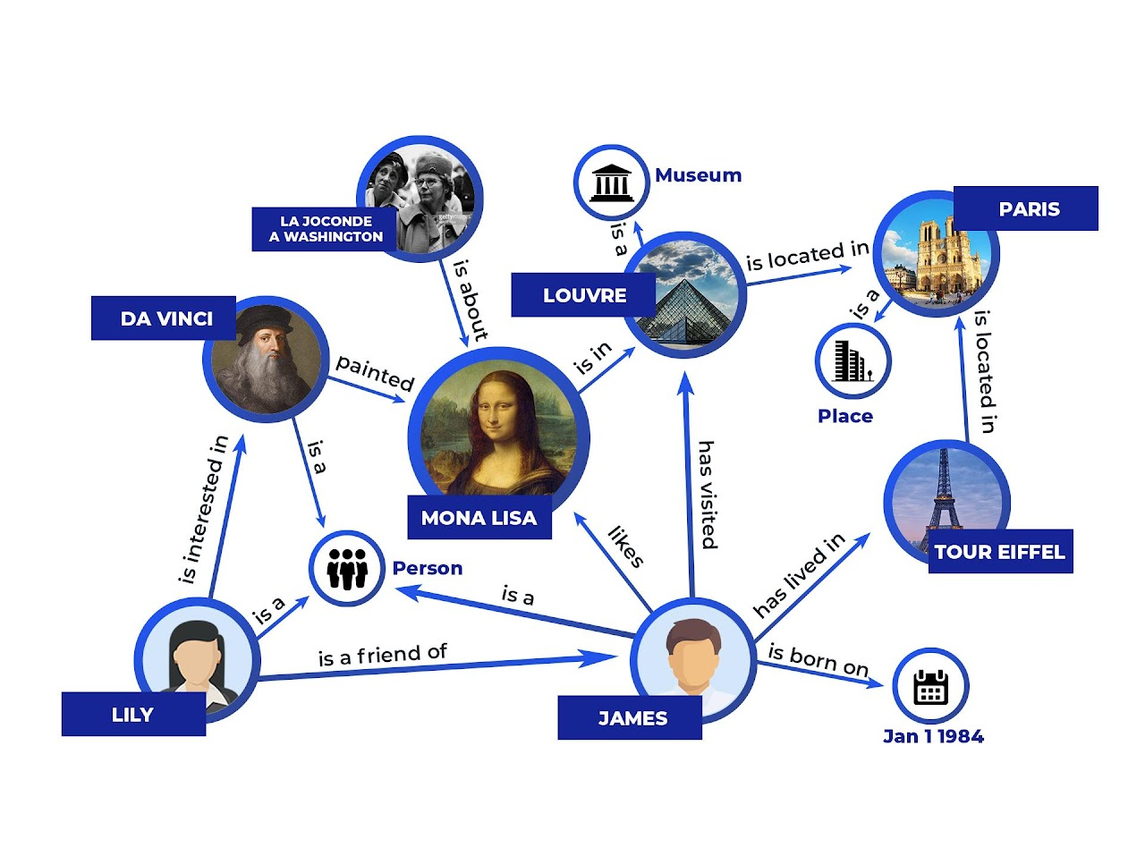
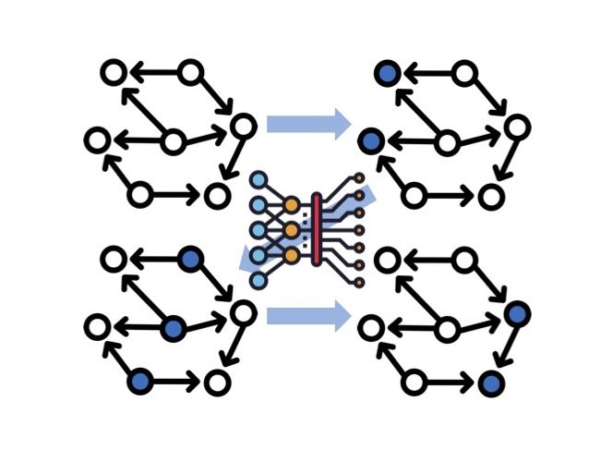
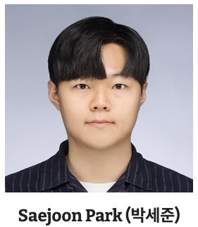
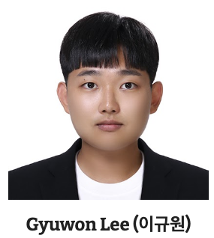
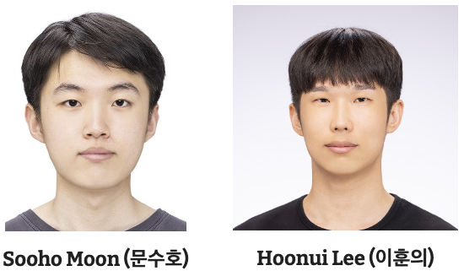
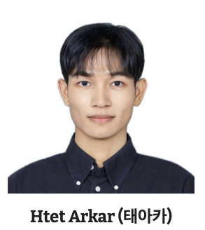
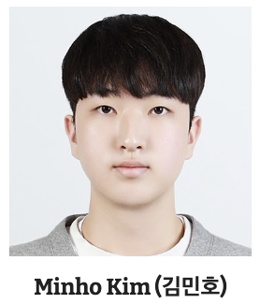
Who Are We?
Current Topics
Time-series Anomaly Detection
Knowledge Graph Reasoning
Graph Neural Networks
Notes:
https://github.com/dmaislab-cau/DMAIS-Lab-Seminar/tree/main

Slide 4
Regular Lab Seminar
Goal
To educate and inform our members of the recent advances of DM and AI
Schedule & Location
Time: 10:00am - 12:00am, every Tuesday
Room: Room #514-1, Building #208
Important notes
If you would like to present in an upcoming meeting, please submit a pull request for registering or email Hoonui Lee (이훈의).
Presenters, (1) please do not forget to upload your presentation slides to this github repository; (2) please also do not forget to forward the papers you are going to represent a week ahead of your presentation.
Link: https://github.com/dmaislab-cau/DMAIS-Lab-Seminar/tree/main

Slide 5
Networks Are Ubiquitous:
Building a Better World through Network Knowledge!
Contact: Yunyong Ko (Email: yyko@cau.ac.kr)

